Slide 1


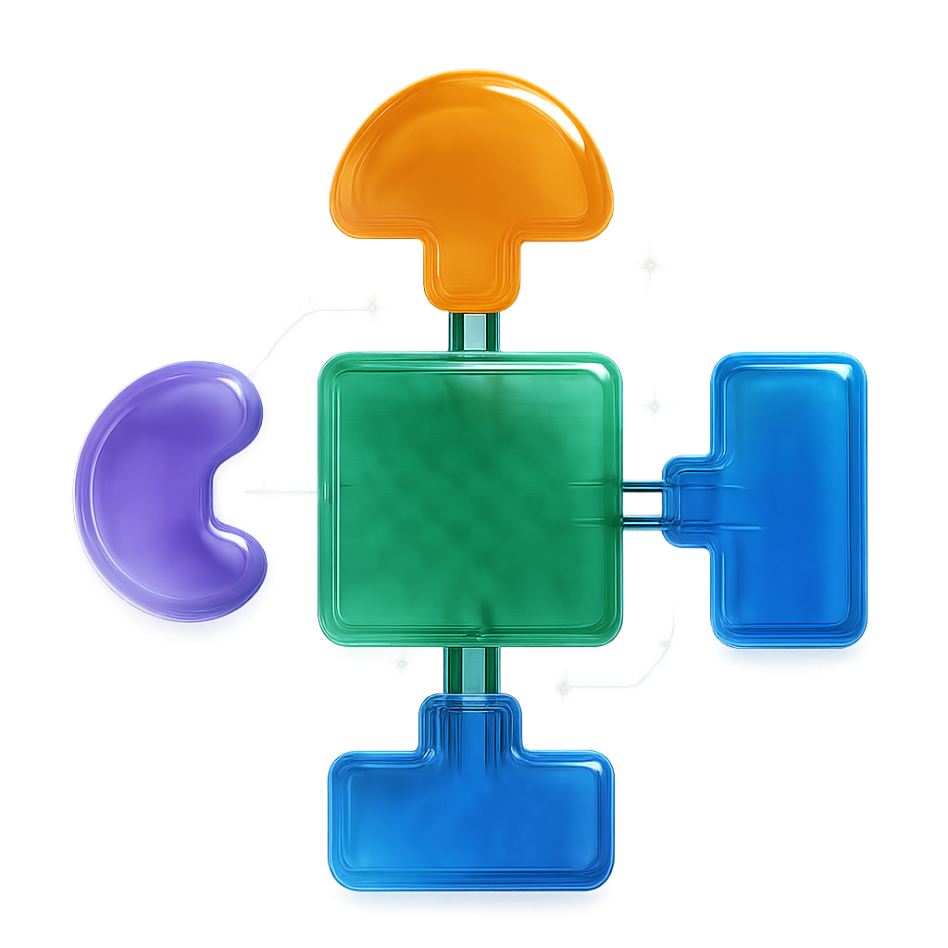
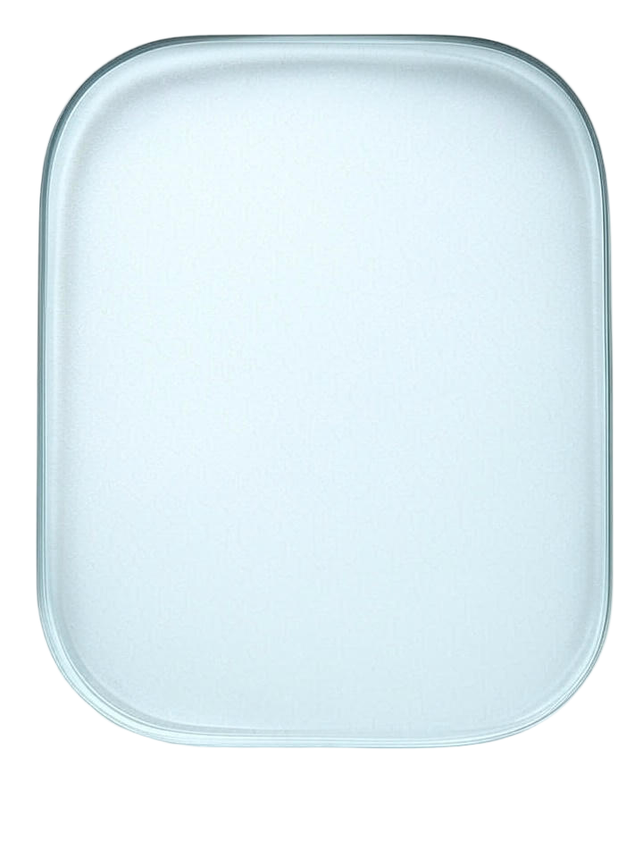

Slide 3

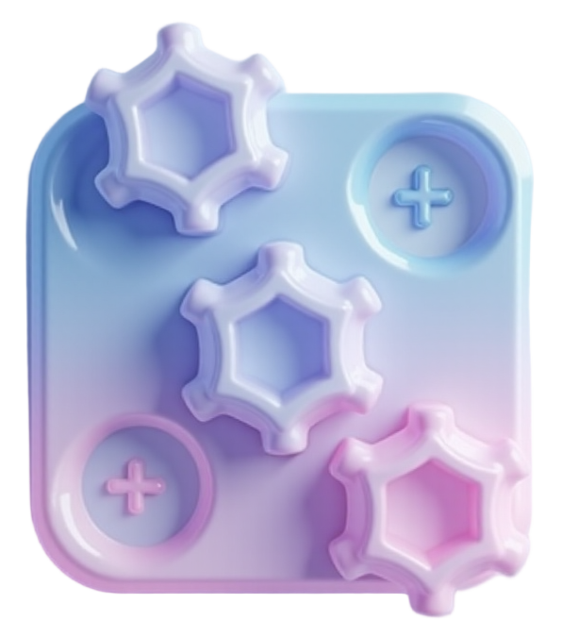
flux
app plugin section icon, like constructor, mechanic or gears with plus(add) icon.
A 3D abstract composition with a soft glassy and matte aesthetic.
on transparent background, with soft glassmorphism lighting and subtle inner shadows.

Slide 4
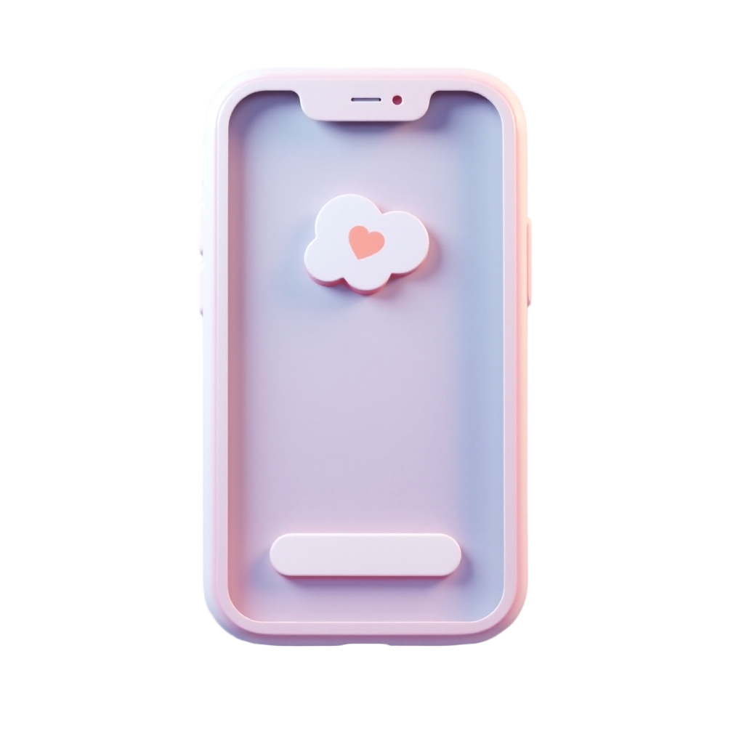
app icon, app feed mobile phone
A 3D abstract composition with a soft glassy and matte aesthetic.
on transparent background, with soft glassmorphism lighting and subtle inner shadows.

Slide 5
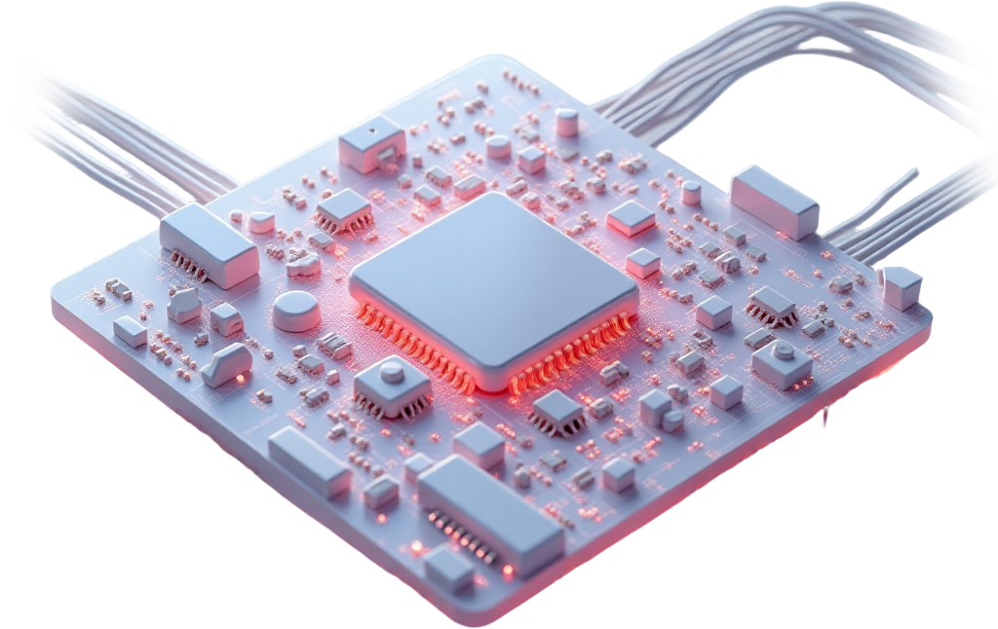
visual programmingnodes, pcb wires, 2-3 blocks. motherboard.
A 3D abstract composition with a soft glassy and matte aesthetic.
on transparent background, with soft glassmorphism lighting and subtle inner shadows.

Slide 6
workflow charts. few figures, graph.
A 3D abstract composition with a soft glassy and matte aesthetic.
on transparent background, with soft glassmorphism lighting and subtle inner shadows.

Slide 7
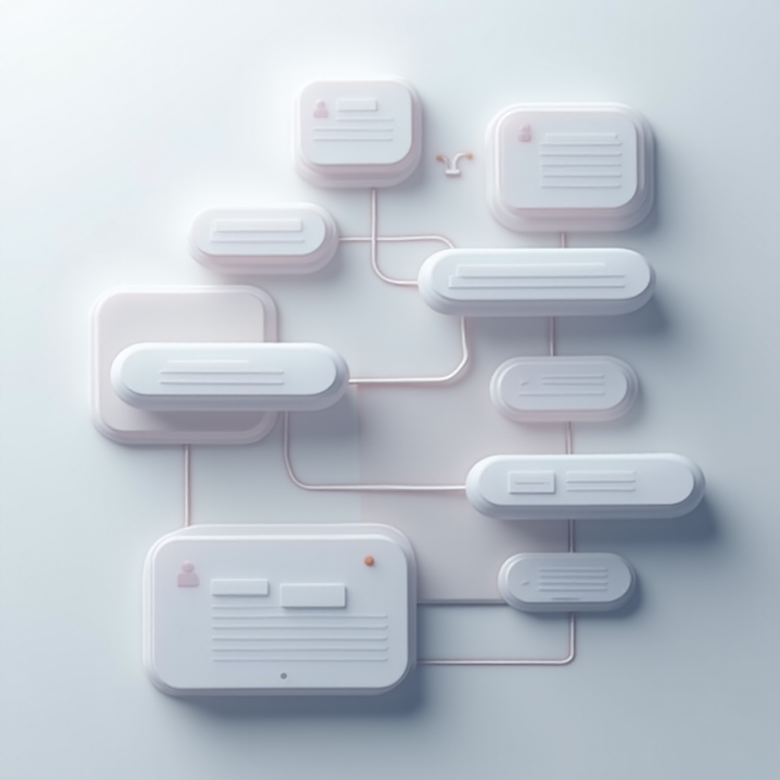
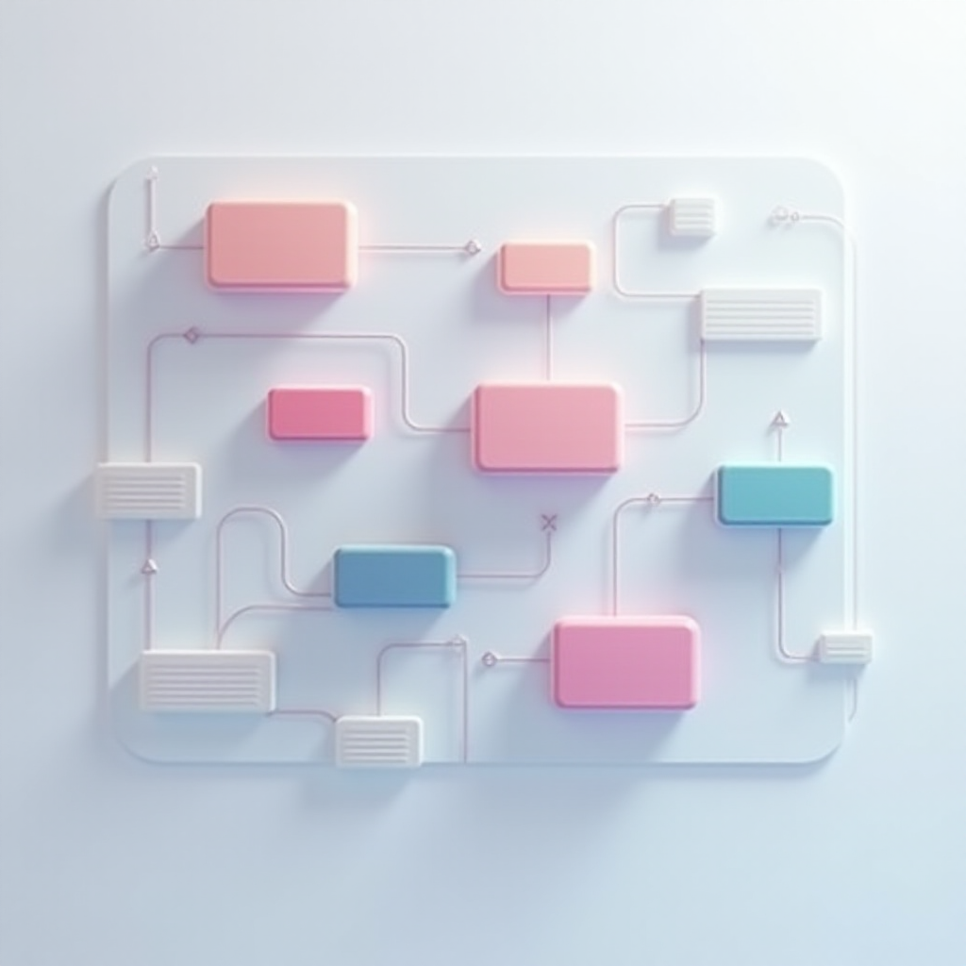
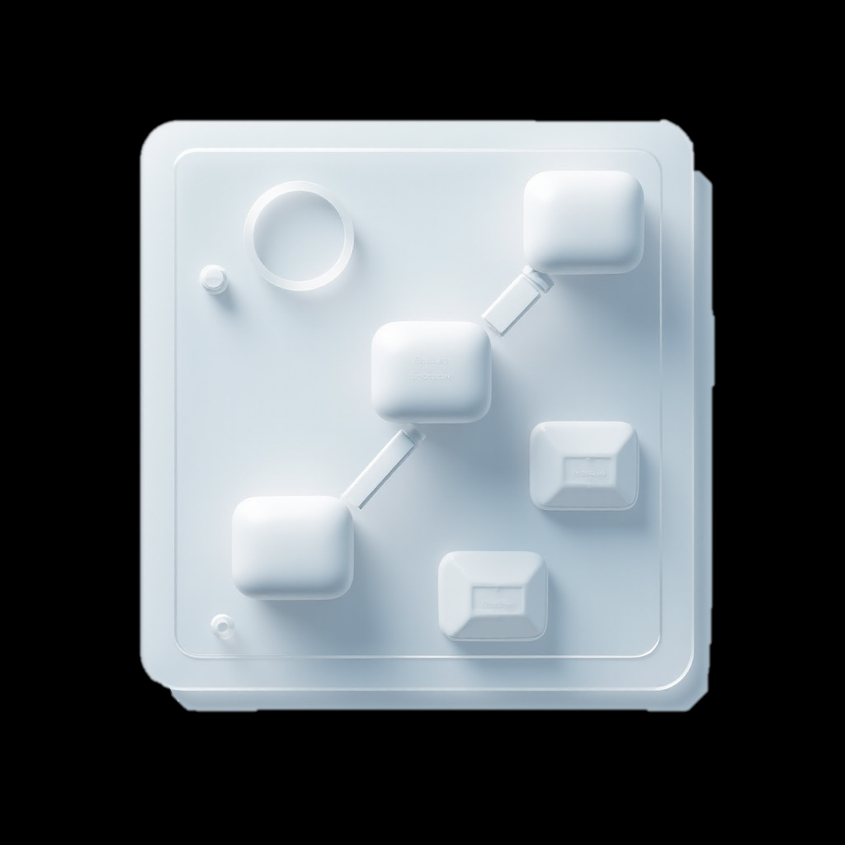
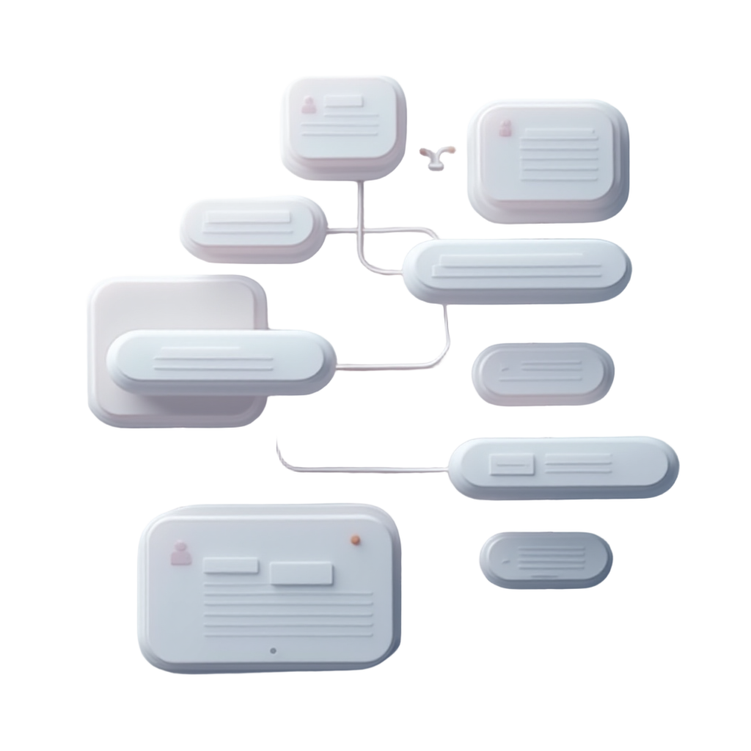
workflow graph, visual programming, chart.
A 3D abstract composition with a soft glassy and matte aesthetic.
on transparent background, with soft glassmorphism lighting and subtle inner shadows.

